Slide 1
DocuBot: AI Powered UiPath Documentation Assistant
Sophiie AI Agents Hackathon (Feb 14-15)

Slide 2

Participant
Phanikiran Pisipati
Automation Analyst @ NSW Department of Customer Service, Sydney
Notes:
Please replace photograph with your team member by right click on image > change picture
Please add role and company name and add your email ID.
Feel free to remove extra picture and details if team size is smaller

Slide 3
Problem Statement & Proposed Solution
Problem
Solution
UiPath documentation is vast and complex, making it difficult for users to find the information they need. Like BFSI environment ,UiPath developers to access the external sites due to restrictions for outside applications.
An AI-powered UiPath Documentation Assistant can help to solve this problem by providing users with a single, easy-to-use interface for accessing all of the UiPath documentation. This Assistant uses Generative AI to understand the user's query and provide them with the most relevant information.
Our solution will be integrated with the UiPath platform, so that UiPath users can easily access it from within the UiPath environment
Notes:
Problem: Please briefly mention what is the problem you are trying to solve / what is problem statement Solution: What approach you took to solve the problem/ what is the solution / your solution to the problem

Slide 4
Benefits & Technologies Used
Details
Benefits
End-User | End Users
User Department | IT
Industries | IT
UiPath Products Used | UiPath Forms
Other – Integrations / APIs / Technologies Used | • GPT-4: Large Language Model (LLM) • RAG: To answer questions about the documentation using the vector DB • Langchain: A framework to interact with LLM • Pinecone vector DB: To store and retrieve the numerical vector embeddings.
An AI-powered UiPath Documentation Assistant can provide a number of benefits to users, including: • Increased productivity: Users can spend less time searching for and trying to understand UiPath documentation. • Reduced errors: Users are less likely to make mistakes when they are using the Assistant to access accurate and up-to-date documentation. • Improved user experience: The Assistant will provide a more user-friendly and interactive way to access UiPath documentation. We believe that the AI-powered UiPath Documentation Assistant will be a valuable tool for UiPath users of all levels of experience. It will help users to automate their tasks more quickly and efficiently, and it will make UiPath more accessible to a wider range of users.
Notes:
Details: Its always good to share details like who is the end-user of your solution, which department/industry will benefit and what technologies have been used.
Benefits: Please include key features / value proposition of your solution

Slide 5
Installation and Solution Guide
Details: Leverage this LLM Framework template along with its Generative AI powered custom activities to make LLM App & Automation Development much easier, more flexible, more reliable and built for enterprise level usage with automation. We've seen how powerful large language models can be, whether it's for generating professional looking essays, responding to emails, extracting entities from unstructured sources, generating works of art, music, etc - that's why we fondly call them generative AI.
.
Notes:
Details: Its always good to share details like who is the end-user of your solution, which department/industry will benefit and what technologies have been used.
Benefits: Please include key features / value proposition of your solution

Slide 6
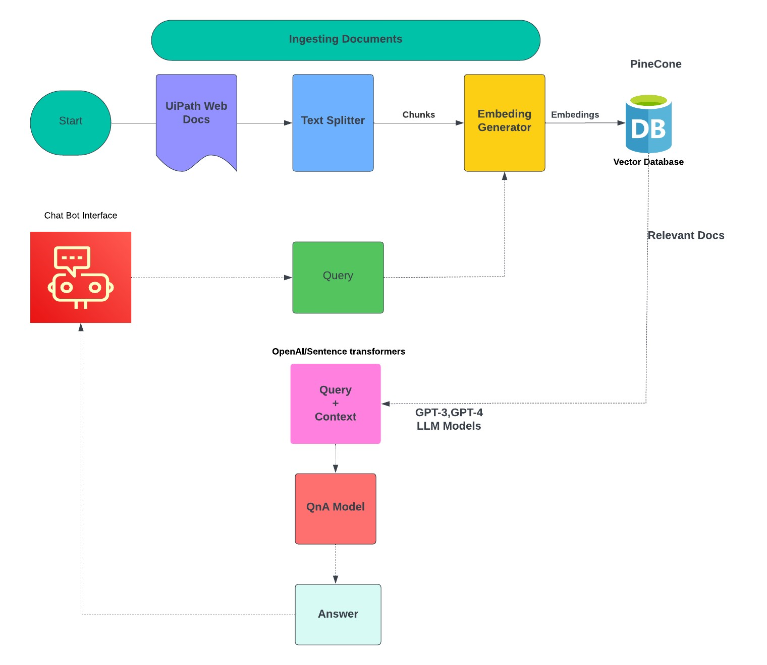
Solution Architecture
Notes:
You can remove the slide if you are not showing Solution Architecture

Slide 7
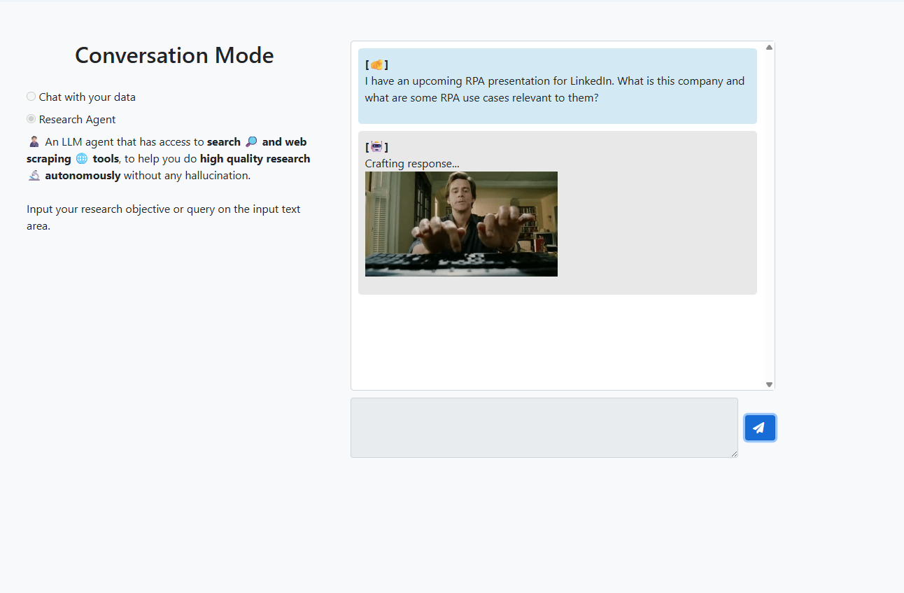

Slide 8
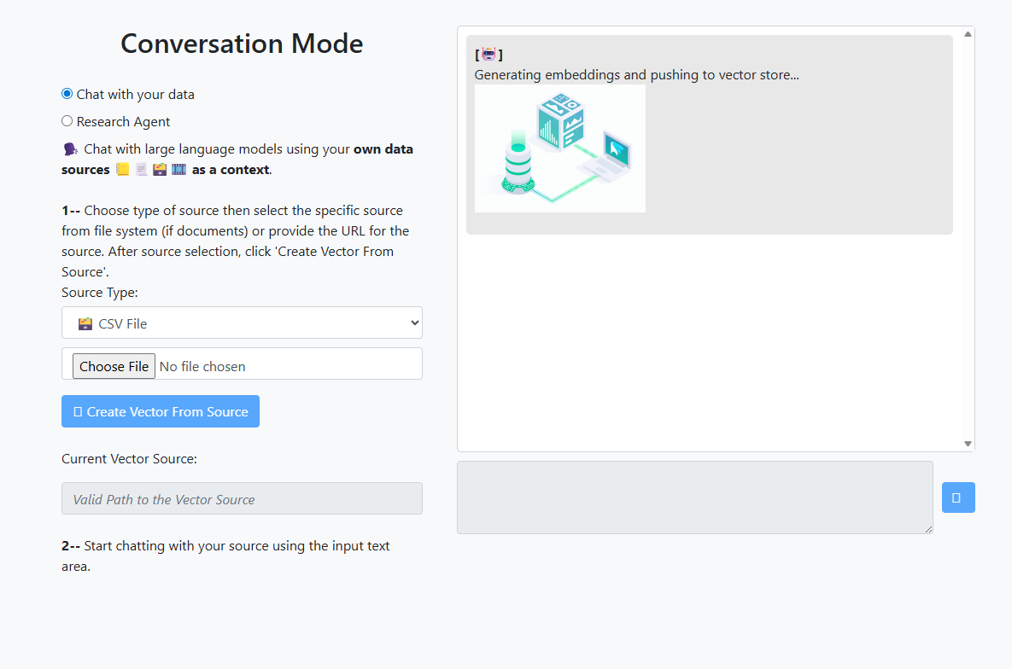

Slide 9
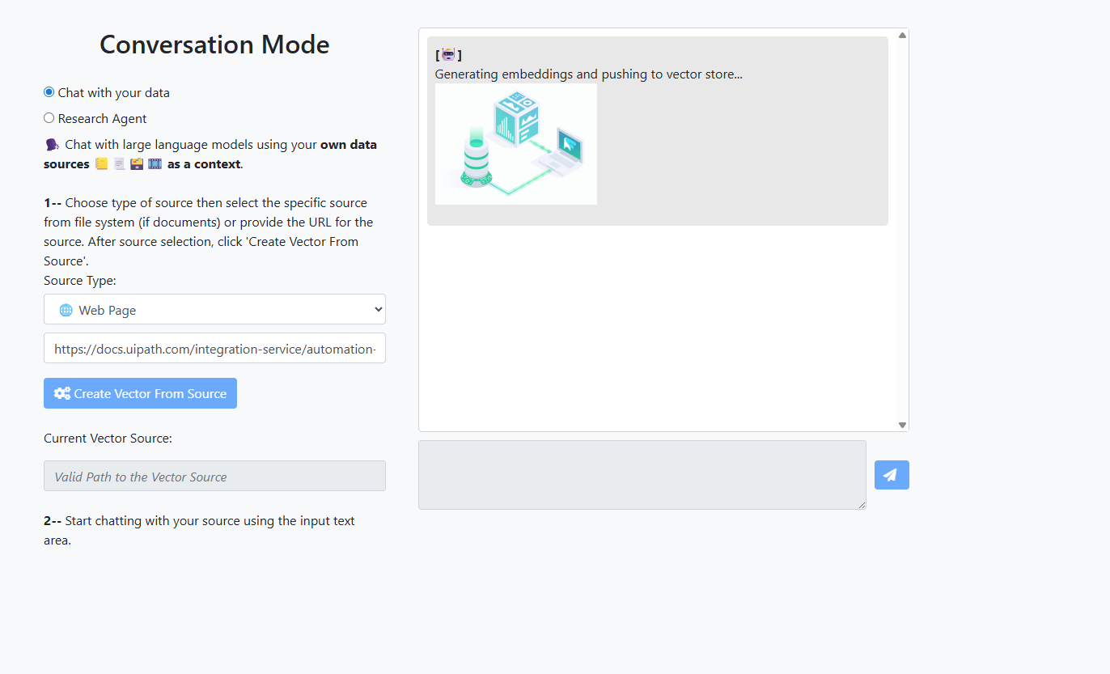

Slide 10


